Slide 1
Unit Testing
Using JUnit Framework

Slide 2
Introduction
Key terms and Terminology

Slide 3
Unit Testing vs. Validation
Unit Testing:
Done by developers
More on verification
Code-based scenarios are examined
Validation
Done by Quality Assurance developers
More on checking if requirements are being followed
Generic judgment by percentage basis

Slide 4
Introduction
Java open source project which offers an extremely useful framework for unit testing
Regression testing is being employed in using JUnit Test recipes
A framework that facilitates project testing – one can test automatically during project build or deployment

Slide 5
Test-driven Development
A style in programming based from the idea that you write a test before the production code to pass that test
Characteristics:
Your system is covered by tests
You build your system from loosely coupled and highly cohesive objects
You make steady progress, improving the system incrementally by making one test pass, then another, then another, and so on…
A passing test is never more than few minutes away

Slide 6
Installation
Download the JAR file in http://www.junit.org
Using command line testing:
Together with ANT, you can put that in ANT_HOM/lib
using Eclipse or Netbeans:
Add the junit.jar into your project

Slide 7
Disadvantage of Threaded Testing
The user has to look at the console o/p and decide whether it is correct or not
No method to collect the results in a structured fashion
After each run a person has to examine and interpret the results .

Slide 8
Using JUnit
The strategy is similar to assertion
Testing by Junit:
assertsEquals(“Message”,2,a.sum());
assertsEquals(“Message”,1,a.sum());
testSomething(TestA)
Just like assertion, it has its own Error class:
junit.framework.AssertionFailedError:
expected:<1> but was:<2>

Slide 9
Requirement
We need to create test cases! ☺

Slide 10
Simple JUnit 3.x Test Case
import junit.framework.TestCase;
public class MoneyTest extends TestCase{
pubic void testAdd(){
Money addend = new Money(30, 0);
Money augend = new Money(20,0);
Money sum = addend.add(augend);
assertEquals(5000, sum.inCents());
}
}

Slide 11
Simple JUnit 4.x Test Case
public class MoneyTest {
@Test
pubic void testAdd(){
Money addend = new Money(30, 0);
Money augend = new Money(20,0);
Money sum = addend.add(augend);
assertEquals(5000, sum.inCents());
}
}

Slide 12
JUnit versions
Has popular 2 versions:
Programmatic version – 3.x
Annotation version – 4.x

Slide 13
The TestCase class
The center of JUnit framework
A TestCase class contains test cases in form of methods
It extends the class Assert which gives the methods that you will use to make assertions on the state of your objects

Slide 14
AssertionFailedError
When an assertions fails, the assertion methods throws an AssertionFailedError
The JUnit framework then catches the above error, mark the test as a failure, remembers that it is failed and then move to the next test case (method)
JUnit list all failed test cases and successful ones

Slide 15
Components of TestCase
Using version 3.x, place the test cases in one or more methods having names starting with "test". If version 4.x, just add annotation @Test above the method description

Slide 16
Components…
In version 3.x, If your test cases use some common data then set it up in a method called "setUp". In version 4.x, we just use @Before on top of the method we want to initialize data.

Slide 17
Components
In version 3.x, the method “tearDown" is used for releasing resources allocated in setup. In version 4.x, we use annotation @After to methods that we want to clean up all objects used during testing

Slide 18
JUnit Assert Methods
assertEquals(“Message”,Ea,Ab)
asserts that the two parameters are equal. a and b must be either the same primitive type or both Objects
Parameters a and b can be both objects or numeric. If numeric we can have an additional parameter called tolerance level
assertTrue(“Message”,boolean) and assertFalse
asserts that a given condition is true
assertNull(“Messsage”,Object) and assertNotNull
asserts that an object is null
assertSame(“Message”,EObject,AObject) ans assertNotSame
asserts that two objects references the same object

Slide 19
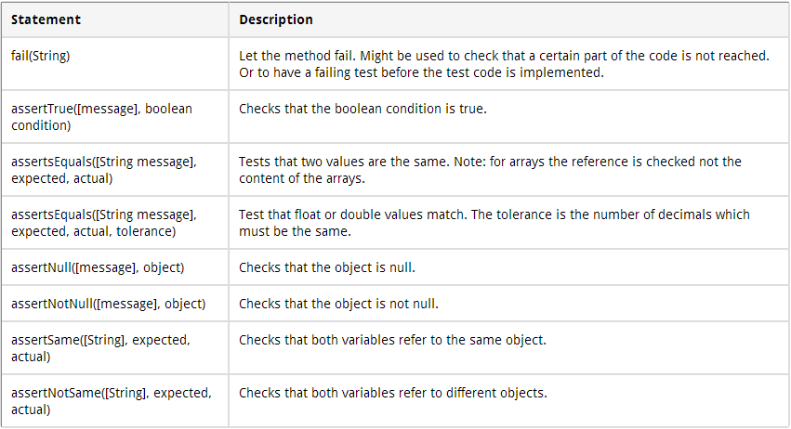
List of Assert Methods

Slide 20
Good Practices
Create test source folder. Do not mix test classes with source files
Tests (methods) must describe the behavior you are testing:
testWithdrawWhenOverdrawn
testDatabaseConnect
test_Spring_DAOConnect
testWithdrawTooMuch
Test cases classes names must come after the name of the class on test
Account → TestAccount
Investment → TestInvestment

Slide 21
Process of Testing
You should focus on the behavior you are testing without worrying which set of classes is under testing
The reason why all method names are written in verb form rather than nouns
We test behavior and not classes

Slide 22
Proper Mindsetting
You have a Stack implementation and you’re gonna test it. Some test cases you will have in mind are:
Popping an empty stock fails somehow
Peeking at an empty stack shows nothing
Push an object into the stack the peek on it expecting the same object you pushed
Push an object into the stack then popped it expecting the same object you pused

Slide 23
The TestSuite class
If you have several test scenarios to test for each TestCase class, use TestSuite
A test class can also invoke other test classes: individual classes, packages, or even the whole system—through Test Suite.
Any test class can contain a static method named suite:
public static TestSuite suite();
Without a suite() method, JUnit runs all of the test. . . methods automatically

Slide 24
TestSuite…
But you might want to add particular tests by hand, including the results from other suites using test suites

Slide 25
Fixtures
Each test should run independently of every other test; this allows you to run any individual test at any time, in any order
You may need to reset some parts of the testing environment in between tests, or clean up after a test has run. JUnit's TestCase base class provides two methods that you can override to set up and then tear down the test's environment:
protected void setUp();
protected void tearDown();

Slide 26
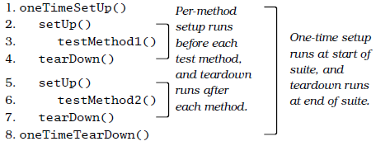
Fixtures…
The method setUp() will be called before each one of the test. . . methods is executed, and the method tearDown() will be called after each test method is executed.

Slide 27
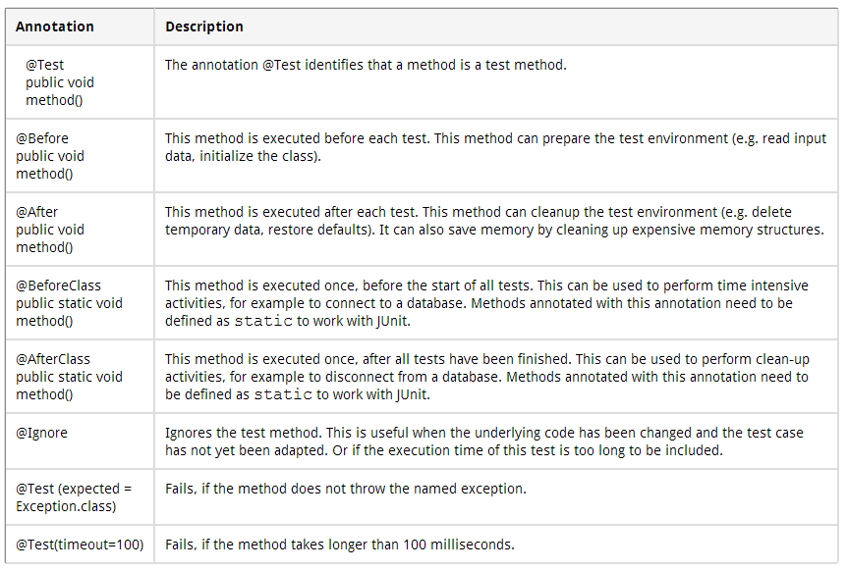
JUnit 4.x Annotations

Slide 28
Exceptions
There are two kinds of exceptions that we might be interested in:
Expected exceptions resulting from a test
Unexpected exceptions from something that's gone horribly wrong
Testing with exceptions is just designing where and when the code will go wrong in the future
Test all possible scenarios that may lead to exceptions soon

Slide 29
Example
You need to test the method call:
sortMyList(List<Integer> listInteger);
One possible test scenario:
public void testForException() {
try {
sortMyList(null);
} catch (RuntimeException e) {
fail("Should have thrown an exception"); }
}

Slide 30
Guiding Rule for Unit Testing
Six specific areas to test that will strengthen your testing skills, using your RIGHT-BICEP:
Right . Are the results right?
B . Are all the boundary conditions CORRECT?
I . Can you check inverse relationships?
C . Can you cross-check results using other means?
E . Can you force error conditions to happen?
P . Are performance characteristics within bounds?

